Slide 1
CSci 3081W: Program Design and Development
Lecture 04 - References and Pointers

Slide 2
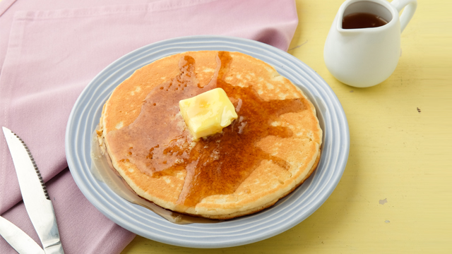


Roadmap for Today
“The Stack” - Layer 1
“The Stack” - Layer N
References
* & ->
Pointers

Slide 3

The Call Stack (a.k.a. “The Stack”) keeps track of variables in memory.
Stack
Queue
First In
Last Out
First In First Out

Slide 4

The Call Stack (a.k.a. “The Stack”) keeps track of variables in memory.
Stack
A Dream within a Dream
Dream 3
Sleep
Wake
Dream 2
Sleep
Wake
Dream 1
Sleep
Wake

Slide 5
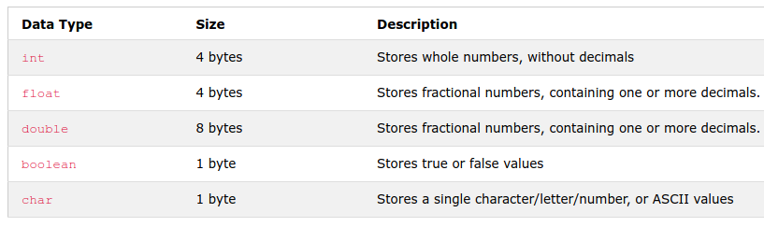
Basic Data Types
Example
int
1, 2, 3, 4, -25, 0, 2343
float
3.14159, -1.5001
double
3.14159, -1.5000000001
boolean
true, false, 0, 1
char
‘A’, ‘a’, ‘b’, ‘C’, ‘1’, ‘6’, ‘\n’
https://www.w3schools.com/cpp/cpp_data_types.asp

Slide 6
Basic Data Types
Example
int
1, 2, 3, 4, -25, 0, 2343
float
3.14159, -1.5001
double
3.14159, -1.5000000001
boolean
true, false, 0, 1
char
‘A’, ‘a’, ‘b’, ‘C’, ‘1’, ‘6’, ‘\n’
https://www.w3schools.com/cpp/cpp_data_types.asp

Slide 7
Let’s take a look at the first layer of the stack.
Address | Content
90000000 | 01010110
90000001 | 00000110
90000002 | 11000111
90000003 | 11000111
90000004 | 11000000
90000005 | 11111011
90000006 | 10000101
90000007 | 10000101
90000008 | 10000100
90000009 | 10110101
9000000A | 11110000
9000000B | 10110000
9000000C | 10110000

Slide 8
Let’s take a look at the first layer of the stack.
Address | Content
90000000 | 01010110
90000001 | 00000110
90000002 | 11000111
90000003 | 11000111
90000004 | 11000000
90000005 | 11111011
90000006 | 10000101
90000007 | 10000101
90000008 | 10000100
90000009 | 10110101
9000000A | 11110000
9000000B | 10110000
9000000C | 10110000

Slide 9
Let’s take a look at the first layer of the stack.
#include <iostream>
using namespace std;
int main() {
float sum = 0.0;
char c = 'a';
float f = 0.1;
for (int i = 0; i < 100; i++) {
sum += f;
}
cout << sum << endl;
}
Address | Content
90000000 | 01010110
90000001 | 00000110
90000002 | 11000111
90000003 | 11000111
90000004 | 11000000
90000005 | 11111011
90000006 | 10000101
90000007 | 10000101
90000008 | 10000100
90000009 | 10110101
9000000A | 11110000
9000000B | 10110000
9000000C | 10110000

Slide 10

Let’s take a look at the first layer of the stack.
#include <iostream>
using namespace std;
int main() {
float sum = 0.0;
char c = 'a';
float f = 0.1;
for (int i = 0; i < 100; i++) {
sum += f;
}
cout << sum << endl;
}
Address | Content
90000000 | 01010110
90000001 | 00000110
90000002 | 11000111
90000003 | 11000111
90000004 | 11000000
90000005 | 11111011
90000006 | 10000101
90000007 | 10000101
90000008 | 10000100
90000009 | 10110101
9000000A | 11110000
9000000B | 10110000
9000000C | 10110000
float sum; (4 bytes)
char c; (1 byte)
float f; (4 bytes)
int i; (4 bytes)

Slide 11
Let’s take a look at the first layer of the stack.
#include <iostream>
using namespace std;
int main() {
float sum = 0.0;
char c = 'a';
float f = 0.1;
for (int i = 0; i < 100; i++) {
sum += f;
}
cout << sum << endl;
}
Address | Content
90000000 | 01010110
90000001 | 00000110
90000002 | 11000111
90000003 | 11000111
90000004 | 11000000
90000005 | 11111011
90000006 | 10000101
90000007 | 10000101
90000008 | 10000100
90000009 | 10110101
9000000A | 11110000
9000000B | 10110000
9000000C | 10110000
Type | Variable | Content
float | sum | 0.0
char | c | ‘a’
float | f | 0.1
int | i | 0

Slide 12
Programs use the stack to store variables and their values
#include <iostream>
using namespace std;
int main() {
float sum = 0.0;
char c = 'a';
float f = 0.1;
for (int i = 0; i < 2; i++) {
sum += f;
}
cout << sum << endl;
}
Type | Variable | Content

Slide 13
Programs use the stack to store variables and their values
#include <iostream>
using namespace std;
int main() {
float sum = 0.0;
char c = 'a';
float f = 0.1;
for (int i = 0; i < 2; i++) {
sum += f;
}
cout << sum << endl;
}
Type | Variable | Content
float | sum | 0.0

Slide 14
Programs use the stack to store variables and their values
#include <iostream>
using namespace std;
int main() {
float sum = 0.0;
char c = 'a';
float f = 0.1;
for (int i = 0; i < 2; i++) {
sum += f;
}
cout << sum << endl;
}
Type | Variable | Content
float | sum | 0.0
char | c | ‘a’

Slide 15
Programs use the stack to store variables and their values
#include <iostream>
using namespace std;
int main() {
float sum = 0.0;
char c = 'a';
float f = 0.1;
for (int i = 0; i < 2; i++) {
sum += f;
}
cout << sum << endl;
}
Type | Variable | Content
float | sum | 0.0
char | c | ‘a’
float | f | 0.1

Slide 16
Programs use the stack to store variables and their values
#include <iostream>
using namespace std;
int main() {
float sum = 0.0;
char c = 'a';
float f = 0.1;
for (int i = 0; i < 2; i++) {
sum += f;
}
cout << sum << endl;
}
Type | Variable | Content
float | sum | 0.0
char | c | ‘a’
float | f | 0.1
int | i | 0

Slide 17
Programs use the stack to store variables and their values
#include <iostream>
using namespace std;
int main() {
float sum = 0.0;
char c = 'a';
float f = 0.1;
for (int i = 0; i < 2; i++) {
sum += f;
}
cout << sum << endl;
}
Type | Variable | Content
float | sum | 0.0 0.1
char | c | ‘a’
float | f | 0.1
int | i | 0

Slide 18
Programs use the stack to store variables and their values
#include <iostream>
using namespace std;
int main() {
float sum = 0.0;
char c = 'a';
float f = 0.1;
for (int i = 0; i < 2; i++) {
sum += f;
}
cout << sum << endl;
}
Type | Variable | Content
float | sum | 0.1
char | c | ‘a’
float | f | 0.1
int | i | 0 1

Slide 19
Programs use the stack to store variables and their values
#include <iostream>
using namespace std;
int main() {
float sum = 0.0;
char c = 'a';
float f = 0.1;
for (int i = 0; i < 2; i++) {
sum += f;
}
cout << sum << endl;
}
Type | Variable | Content
float | sum | 0.1
char | c | ‘a’
float | f | 0.1
int | i | 1
1 < 2?

Slide 20
Programs use the stack to store variables and their values
#include <iostream>
using namespace std;
int main() {
float sum = 0.0;
char c = 'a';
float f = 0.1;
for (int i = 0; i < 2; i++) {
sum += f;
}
cout << sum << endl;
}
Type | Variable | Content
float | sum | 0.1 0.2
char | c | ‘a’
float | f | 0.1
int | i | 1

Slide 21
Programs use the stack to store variables and their values
#include <iostream>
using namespace std;
int main() {
float sum = 0.0;
char c = 'a';
float f = 0.1;
for (int i = 0; i < 2; i++) {
sum += f;
}
cout << sum << endl;
}
Type | Variable | Content
float | sum | 0.2
char | c | ‘a’
float | f | 0.1
int | i | 1 2

Slide 22
Programs use the stack to store variables and their values
#include <iostream>
using namespace std;
int main() {
float sum = 0.0;
char c = 'a';
float f = 0.1;
for (int i = 0; i < 2; i++) {
sum += f;
}
cout << sum << endl;
}
Type | Variable | Content
float | sum | 0.2
char | c | ‘a’
float | f | 0.1
int | i | 2
2 < 2?

Slide 23
Programs use the stack to store variables and their values
#include <iostream>
using namespace std;
int main() {
float sum = 0.0;
char c = 'a';
float f = 0.1;
for (int i = 0; i < 2; i++) {
sum += f;
}
cout << sum << endl;
}
Type | Variable | Content
float | sum | 0.2
char | c | ‘a’
float | f | 0.1
int | i | 2
Output: 0.2

Slide 24
Roadmap for Today
“The Stack” - Layer 1
“The Stack” - Layer N
References
* & ->
Pointers

Slide 25
Each time a function is called the stack size increases
Layer 1
Address | Content
90000000 | 01010110
90000001 | 00000110
90000002 | 11000111
90000003 | 11000111
90000004 | 11000000
90000005 | 11111011
90000006 | 10000101
90000007 | 10000101
90000008 | 10000100
90000009 | 10110101
9000000A | 11110000
9000000B | 10110000
9000000C | 10110000
Layer N
Layer 2
...
Layer 3
Layer 2
Layer 3
Layer 1
Layer 4

Slide 26
In order to understand the stack, we add two more columns.
#include <iostream>
using namespace std;
float add(float a, float b);
float double_value(float x);
int main() {
float val = 5.0;
cout << double_value(val) << endl;
}
float add(float a, float b) {
return a + b;
}
float double_value(float x) {
x = add(x, x);
return x;
}
Layer | Function | Type | Variable | Content

Slide 27
In order to understand the stack, we add two more columns.
#include <iostream>
using namespace std;
float add(float a, float b);
float double_value(float x);
int main() {
float val = 5.0;
cout << double_value(val) << endl;
}
float add(float a, float b) {
return a + b;
}
float double_value(float x) {
x = add(x, x);
return x;
}
Layer | Function | Type | Variable | Content
1 | main | float | val | 5.0

Slide 28
In order to understand the stack, we add two more columns.
#include <iostream>
using namespace std;
float add(float a, float b);
float double_value(float x);
int main() {
float val = 5.0;
cout << double_value(val) << endl;
}
float add(float a, float b) {
return a + b;
}
float double_value(float x) {
x = add(x, x);
return x;
}
Layer | Function | Type | Variable | Content
1 | main | float | val | 5.0
2 | double_value

Slide 29
In order to understand the stack, we add two more columns.
#include <iostream>
using namespace std;
float add(float a, float b);
float double_value(float x);
int main() {
float val = 5.0;
cout << double_value(val) << endl;
}
float add(float a, float b) {
return a + b;
}
float double_value(float x) {
x = add(x, x);
return x;
}
Layer | Function | Type | Variable | Content
1 | main | float | val | 5.0
2 | double_value | float | x | 5.0

Slide 30
In order to understand the stack, we add two more columns.
#include <iostream>
using namespace std;
float add(float a, float b);
float double_value(float x);
int main() {
float val = 5.0;
cout << double_value(val) << endl;
}
float add(float a, float b) {
return a + b;
}
float double_value(float x) {
x = add(x, x);
return x;
}
Layer | Function | Type | Variable | Content
1 | main | float | val | 5.0
2 | double_value | float | x | 5.0
3 | add

Slide 31
In order to understand the stack, we add two more columns.
#include <iostream>
using namespace std;
float add(float a, float b);
float double_value(float x);
int main() {
float val = 5.0;
cout << double_value(val) << endl;
}
float add(float a, float b) {
return a + b;
}
float double_value(float x) {
x = add(x, x);
return x;
}
Layer | Function | Type | Variable | Content
1 | main | float | val | 5.0
2 | double_value | float | x | 5.0
3 | add | float | a | 5.0
3 | add | float | b | 5.0

Slide 32
In order to understand the stack, we add two more columns.
#include <iostream>
using namespace std;
float add(float a, float b);
float double_value(float x);
int main() {
float val = 5.0;
cout << double_value(val) << endl;
}
float add(float a, float b) {
return a + b;
}
float double_value(float x) {
x = add(x, x);
return x;
}
Layer | Function | Type | Variable | Content
1 | main | float | val | 5.0
2 | double_value | float | x | 10.0
3 | add | float | a | 5.0
3 | add | float | b | 5.0
3 | add | float | return | 10.0

Slide 33
In order to understand the stack, we add two more columns.
Cout << 10 << endl;
#include <iostream>
using namespace std;
float add(float a, float b);
float double_value(float x);
int main() {
float val = 5.0;
cout << double_value(val) << endl;
}
float add(float a, float b) {
return a + b;
}
float double_value(float x) {
x = add(x, x);
return x;
}
Layer | Function | Type | Variable | Content
1 | main | float | val | 5.0
2 | double_value | float | x | 10.0
2 | double_value | float | return | 10.0

Slide 34
In order to understand the stack, we add two more columns.
Cout << 10 << endl;
#include <iostream>
using namespace std;
float add(float a, float b);
float double_value(float x);
int main() {
float val = 5.0;
cout << double_value(val) << endl;
}
float add(float a, float b) {
return a + b;
}
float double_value(float x) {
x = add(x, x);
return x;
}
Layer | Function | Type | Variable | Content
1 | main | float | val | 5.0

Slide 35
The call stack increases every time we call a function.
#include <iostream>
using namespace std;
float double_value(float x);
int main() {
float val = 1.0;
val = double_value(val);
}
float double_value(float x) {
return double_value(x+x);
}
Layer | Function | Type | Variable | Content
1 | main | float | val | 1.0

Slide 36
The call stack increases every time we call a function.
#include <iostream>
using namespace std;
float double_value(float x);
int main() {
float val = 1.0;
val = double_value(val);
}
float double_value(float x) {
return double_value(x+x);
}
Layer | Function | Type | Variable | Content
1 | main | float | val | 1.0
2 | double_value

Slide 37
The call stack increases every time we call a function.
#include <iostream>
using namespace std;
float double_value(float x);
int main() {
float val = 1.0;
val = double_value(val);
}
float double_value(float x) {
return double_value(x+x);
}
Layer | Function | Type | Variable | Content
1 | main | float | val | 1.0
2 | double_value | float | x | 1.0

Slide 38
The call stack increases every time we call a function.
#include <iostream>
using namespace std;
float double_value(float x);
int main() {
float val = 1.0;
val = double_value(val);
}
float double_value(float x) {
return double_value(x+x);
}
Layer | Function | Type | Variable | Content
1 | main | float | val | 1.0
2 | double_value | float | x | 1.0
3 | double_value

Slide 39
The call stack increases every time we call a function.
#include <iostream>
using namespace std;
float double_value(float x);
int main() {
float val = 1.0;
val = double_value(val);
}
float double_value(float x) {
return double_value(x+x);
}
Layer | Function | Type | Variable | Content
1 | main | float | val | 1.0
2 | double_value | float | x | 1.0
3 | double_value | float | x | 2.0

Slide 40
The call stack increases every time we call a function.
#include <iostream>
using namespace std;
float double_value(float x);
int main() {
float val = 1.0;
val = double_value(val);
}
float double_value(float x) {
return double_value(x+x);
}
Layer | Function | Type | Variable | Content
1 | main | float | val | 1.0
2 | double_value | float | x | 1.0
3 | double_value | float | x | 2.0
4 | double_value

Slide 41
The call stack increases every time we call a function.
#include <iostream>
using namespace std;
float double_value(float x);
int main() {
float val = 1.0;
val = double_value(val);
}
float double_value(float x) {
return double_value(x+x);
}
Layer | Function | Type | Variable | Content
1 | main | float | val | 1.0
2 | double_value | float | x | 1.0
3 | double_value | float | x | 2.0
4 | double_value | float | x | 4.0

Slide 42
The call stack increases every time we call a function.
#include <iostream>
using namespace std;
float double_value(float x);
int main() {
float val = 1.0;
val = double_value(val);
}
float double_value(float x) {
return double_value(x+x);
}
Layer | Function | Type | Variable | Content
1 | main | float | val | 1.0
2 | double_value | float | x | 1.0
3 | double_value | float | x | 2.0
4 | double_value | float | x | 4.0
5 | double_value | float | x | 8
6 | double_value | float | x | 16
7 | double_value | float | x | 32
8 | double_value | float | x | 64
9 | double_value | float | x | 128
10 | double_value | float | x | 256
11 | double_value | float | x | 512
... | ... | ... | ... | ...

Slide 43
What do you think will happen here?
#include <iostream>
using namespace std;
float double_value(float x);
int main() {
float val = 1.0;
val = double_value(val);
}
float double_value(float x) {
return double_value(x+x);
}
Layer | Function | Type | Variable | Content
1 | main | float | val | 1.0
2 | double_value | float | x | 1.0
3 | double_value | float | x | 2.0
4 | double_value | float | x | 4.0
5 | double_value | float | x | 8
6 | double_value | float | x | 16
7 | double_value | float | x | 32
8 | double_value | float | x | 64
9 | double_value | float | x | 128
10 | double_value | float | x | 256
11 | double_value | float | x | 512
... | ... | ... | ... | ...

Slide 44
The call stack increases every time we call a function.
#include <iostream>
using namespace std;
float double_value(float x);
int main() {
float val = 1.0;
val = double_value(val);
}
float double_value(float x) {
return double_value(x+x);
}
Layer | Function | Type | Variable | Content
1 | main | float | val | 1.0
2 | double_value | float | x | 1.0
3 | double_value | float | x | 2.0
4 | double_value | float | x | 4.0
5 | double_value | float | x | 8
6 | double_value | float | x | 16
7 | double_value | float | x | 32
8 | double_value | float | x | 64
9 | double_value | float | x | 128
10 | double_value | float | x | 256
11 | double_value | float | x | 512
... | ... | ... | ... | ...
Stack Overflow!!!
(runs out of stack memory)

Slide 45
Roadmap for Today
“The Stack” - Layer 1
“The Stack” - Layer N
References
* & ->
Pointers

Slide 46
References are like aliases for existing variables (e.g. int& b)
int a = 10;

Slide 47
References are like aliases for existing variables (e.g. int& b)
int a = 10;
Type
Declares Reference Type
Variable Name
int& b = a;

Slide 48
References are like aliases for existing variables (e.g. int& b)
int a = 10;
Type
Declares Reference Type
Variable Name
int& b = a;
References “point” to the same memory as another variable.

Slide 49
References are like aliases for existing variables (e.g. int& b)
#include <iostream>
using namespace std;
int main()
{
int a = 10;
int& b = a;
b++;
cout << a << " " << b << endl;
b = 32;
// a = 32;
cout << a << " " << b << endl;
return 0;
}
b is another name for the variable a
a and b point to the same memory!
When a change occurs in one, the other changes since it is the same memory being updated.

Slide 50
Why should we use them?
#include <iostream>
using namespace std;
int main()
{
int a = 10;
int& b = a;
b++;
cout << a << " " << b << endl;
a = 32;
cout << a << " " << b << endl;
return 0;
}

Slide 51
References are considered “safe” pointers with restrictions.
Address | Content
90000000 | 01010110
90000001 | 00000110
90000002 | 11000111
90000003 | 11000111
90000004 | 11000000
90000005 | 11111011
90000006 | 10000101
90000007 | 10000101
90000008 | 10000100
90000009 | 10110101
9000000A | 10110101
9000000B | 10110101
A reference saves the address to a variable in memory.
float sum; (4 bytes)
float& sumReference; (8 bytes)
= 9000000

Slide 52
References are considered “safe” pointers with restrictions.
Address | Content
90000000 | 01010110
90000001 | 00000110
90000002 | 11000111
90000003 | 11000111
90000004 | 11000000
90000005 | 11111011
90000006 | 10000101
90000007 | 10000101
90000008 | 10000100
90000009 | 10110101
9000000A | 10110101
9000000B | 10110101
A reference saves the address to a variable in memory.
float sum; (4 bytes)
Restrictions
The memory is assumed to exist!
Cannot point to invalid location
It must be initialized from another variable.
It cannot be changed.
float& sumReference = sum;
(8 bytes)
= 9000000

Slide 53
Read Only Variables: The keyword const means that the variable cannot be changed.
#include <iostream>
using namespace std;
int main()
{
int a = 10;
const int& b = a;
b++;
cout << a << " " << b << endl;
a = 32;
cout << a << " " << b << endl;
return 0;
}
Fail!

Slide 54
Output Parameters: Passing by reference allows you to change variables within a function.
#include <iostream>
using namespace std;
void add(int a, int b, int& sum) {
sum = a + b;
}
int main()
{
int sum;
add(1, 2, sum);
cout << sum << endl;
return 0;
}
Sum is changed within the add function!

Slide 55
Output Parameters: Passing by reference allows you to change variables within a function.
Pass by Value - Makes Copy
#include <iostream>
using namespace std;
void add(int a, int b, int& sum) {
sum = a + b;
}
int main()
{
int sum;
add(1, 2, sum);
cout << sum << endl;
return 0;
}
Pass by Reference - Same Memory
Sum is changed within the add function!

Slide 56
Key Takeaway: In functions, pass by reference if you would like to use parameters as output variables.
int divide(int a, int b, int& remainder) {
remainder = a % b;
return a / b;
}
Here we get the remainder from the parameter.
Multiple outputs!

Slide 57

Consider a data structure for an employee at a company using C++.
Name
Employee ID
Salary
Date of Birth
Age
Phone Number
Email
etc...
class Employee {
...
};
...
Employee jsmith;

Slide 58
Consider a data structure for an employee at a company using C++.
Name
Employee ID
Salary
Date of Birth
Age
Phone Number
Email
etc...
struct Employee {
...
};
...
Employee jsmith;

Slide 59
Consider a data structure for an employee at a company using C++.
Name
Employee ID
Salary
Date of Birth
Age
Phone Number
Email
etc...
struct Date {
int month;
int day;
int year;
};
struct PhoneNumber {
int areaCode;
int number;
};
struct Employee {
char name[50];
int id;
float salary;
Date dateOfBirth;
int age;
PhoneNumber phone;
char email[100];
};

Slide 60
Consider a data structure for an employee at a company using C++.
Name
Employee ID
Salary
Date of Birth
Age
Phone Number
Email
etc...
Manager
struct Date {
int month;
int day;
int year;
};
struct PhoneNumber {
int areaCode;
int number;
};
struct Employee {
char name[50];
int id;
float salary;
Date dateOfBirth;
int age;
PhoneNumber phone;
char email[100];
Employee manager; // ????
};

Slide 61
Consider a data structure for an employee at a company using C++.
Name
Employee ID
Salary
Date of Birth
Age
Phone Number
Email
etc...
Manager
struct Date {
int month;
int day;
int year;
};
struct PhoneNumber {
int areaCode;
int number;
};
struct Employee {
char name[50];
int id;
float salary;
Date dateOfBirth;
int age;
PhoneNumber phone;
char email[100];
Employee manager; // ????
};
Incomplete Type!

Slide 62
Consider a data structure for an employee at a company using C++.
Name
Employee ID
Salary
Date of Birth
Age
Phone Number
Email
etc...
Manager
struct Date {
int month;
int day;
int year;
};
struct PhoneNumber {
int areaCode;
int number;
};
struct Employee {
char name[50];
int id;
float salary;
Date dateOfBirth;
int age;
PhoneNumber phone;
char email[100];
Employee& manager; // ????
};

Slide 63
Consider a data structure for an employee at a company using C++.
Name
Employee ID
Salary
Date of Birth
Age
Phone Number
Email
etc...
Manager
struct Date {
int month;
int day;
int year;
};
struct PhoneNumber {
int areaCode;
int number;
};
struct Employee {
char name[50];
int id;
float salary;
Date dateOfBirth;
int age;
PhoneNumber phone;
char email[100];
Employee& manager; // ????
};
Uninitialized Reference

Slide 64
Consider a data structure for an employee at a company using C++.
Name
Employee ID
Salary
Date of Birth
Age
Phone Number
Email
etc...
Manager
struct Date {
int month;
int day;
int year;
};
struct PhoneNumber {
int areaCode;
int number;
};
struct Employee {
char name[50];
int id;
float salary;
Date dateOfBirth;
int age;
PhoneNumber phone;
char email[100];
Employee* manager;
};
First example of where pointers are useful!

Slide 65
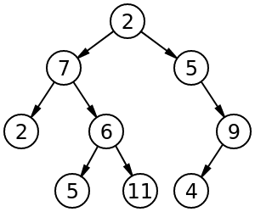
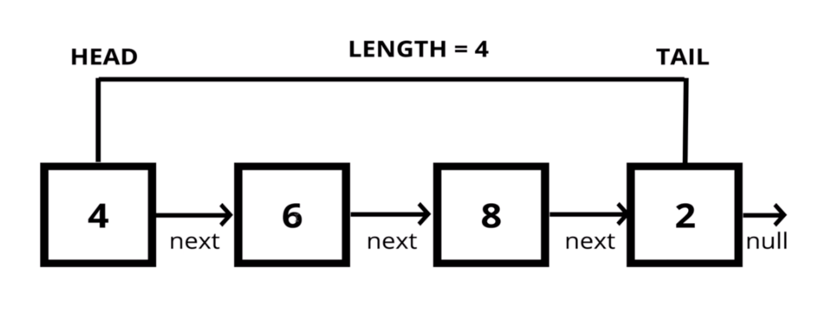
Common data structures like linked lists and binary trees use this technique.
// Linked List
struct Node {
DataType data;
Node* next;
}
// Binary Tree
struct Node {
DataType data;
Node* left;
Node* right;
}

Slide 66
Roadmap for Today
“The Stack” - Layer 1
“The Stack” - Layer N
References
* & ->
Pointers

Slide 67
Recall: References use the same address as a variable.
#include <iostream>
using namespace std;
int main()
{
int a = 10;
int& b = a;
b++;
cout << a << endl;
return 0;
}
Why is the output for a 11?

Slide 68
Recall: References use the same address as a variable.
Memory
#include <iostream>
using namespace std;
int main()
{
int a = 10;
int& b = a;
b++;
cout << a << endl;
return 0;
}
Variable | Value

Slide 69
Recall: References use the same address as a variable.
Memory
#include <iostream>
using namespace std;
int main()
{
int a = 10;
int& b = a;
b++;
cout << a << endl;
return 0;
}
Variable | Value
a | 10

Slide 70
Recall: References use the same address as a variable.
Memory
#include <iostream>
using namespace std;
int main()
{
int a = 10;
int& b = a;
b++;
cout << a << endl;
return 0;
}
Variable | Value
a | 10
b

Slide 71
Recall: References use the same address as a variable.
Memory
#include <iostream>
using namespace std;
int main()
{
int a = 10;
int& b = a;
b++;
cout << a << endl;
return 0;
}
Variable | Value
a | 10 11
b

Slide 72
Recall: References use the same address as a variable.
Memory
#include <iostream>
using namespace std;
int main()
{
int a = 10;
int& b = a;
b++;
cout << a << endl;
return 0;
}
Variable | Value
a | 10 11
b

Slide 73
Recall: Passing by value makes a copy of the memory.
Memory
#include <iostream>
using namespace std;
float add(int x, int y) {
return x+y;
}
int main()
{
int a = 1;
int b = 2;
int sum;
sum = add(a, b);
cout << sum << endl;
return 0;
}
Variable | Value

Slide 74
Recall: Passing by value makes a copy of the memory.
Memory
#include <iostream>
using namespace std;
float add(int x, int y) {
return x+y;
}
int main()
{
int a = 1;
int b = 2;
int sum;
sum = add(a, b);
cout << sum << endl;
return 0;
}
Variable | Value
a | 1

Slide 75
Recall: Passing by value makes a copy of the memory.
Memory
#include <iostream>
using namespace std;
float add(int x, int y) {
return x+y;
}
int main()
{
int a = 1;
int b = 2;
int sum;
sum = add(a, b);
cout << sum << endl;
return 0;
}
Variable | Value
a | 1
b | 2

Slide 76
Recall: Passing by value makes a copy of the memory.
Memory
#include <iostream>
using namespace std;
float add(int x, int y) {
return x+y;
}
int main()
{
int a = 1;
int b = 2;
int sum;
sum = add(a, b);
cout << sum << endl;
return 0;
}
Variable | Value
a | 1
b | 2
sum | ?

Slide 77
Recall: Passing by value makes a copy of the memory.
Memory
#include <iostream>
using namespace std;
float add(int x, int y) {
return x+y;
}
int main()
{
int a = 1;
int b = 2;
int sum;
sum = add(a, b);
cout << sum << endl;
return 0;
}
Variable | Value
a | 1
b | 2
sum | ?
x | 1
y | 2
Notice the copy of a and b here

Slide 78
Recall: Passing by value makes a copy of the memory.
Memory
#include <iostream>
using namespace std;
float add(int x, int y) {
return x+y;
}
int main()
{
int a = 1;
int b = 2;
int sum;
sum = add(a, b);
cout << sum << endl;
return 0;
}
Variable | Value
a | 1
b | 2
sum | ? 3
x | 1
y | 2

Slide 79
Recall: Passing by value makes a copy of the memory.
Memory
#include <iostream>
using namespace std;
float add(int x, int y) {
return x+y;
}
int main()
{
int a = 1;
int b = 2;
int sum;
sum = add(a, b);
cout << sum << endl;
return 0;
}
Variable | Value
a | 1
b | 2
sum | ? 3
x | 1
y | 2
Notice x and y no longer exist

Slide 80
Recall: Passing by reference uses the same memory address.
Memory
#include <iostream>
using namespace std;
void add(int x, int y, int& s) {
s = x+y;
x++;
y = x + 1;
}
int main()
{
int a = 1;
int b = 2;
int sum = 0;
add(a, b, sum);
cout << a << " " << b << " " << sum << endl;
return 0;
}
Variable | Value

Slide 81
Recall: Passing by reference uses the same memory address.
Memory
#include <iostream>
using namespace std;
void add(int x, int y, int& s) {
s = x+y;
x++;
y = x + 1;
}
int main()
{
int a = 1;
int b = 2;
int sum = 0;
add(a, b, sum);
cout << a << " " << b << " " << sum << endl;
return 0;
}
Variable | Value
a | 1

Slide 82
Recall: Passing by reference uses the same memory address.
Memory
#include <iostream>
using namespace std;
void add(int x, int y, int& s) {
s = x+y;
x++;
y = x + 1;
}
int main()
{
int a = 1;
int b = 2;
int sum = 0;
add(a, b, sum);
cout << a << " " << b << " " << sum << endl;
return 0;
}
Variable | Value
a | 1
b | 2

Slide 83
Recall: Passing by reference uses the same memory address.
Memory
#include <iostream>
using namespace std;
void add(int x, int y, int& s) {
s = x+y;
x++;
y = x + 1;
}
int main()
{
int a = 1;
int b = 2;
int sum = 0;
add(a, b, sum);
cout << a << " " << b << " " << sum << endl;
return 0;
}
Variable | Value
a | 1
b | 2
sum | 0

Slide 84
Recall: Passing by reference uses the same memory address.
Memory
#include <iostream>
using namespace std;
void add(int x, int y, int& s) {
s = x+y;
x++;
y = x + 1;
}
int main()
{
int a = 1;
int b = 2;
int sum = 0;
add(a, b, sum);
cout << a << " " << b << " " << sum << endl;
return 0;
}
Variable | Value
a | 1
b | 2
sum | 0
x | 1
y | 2
s

Slide 85
Recall: Passing by reference uses the same memory address.
Memory
#include <iostream>
using namespace std;
void add(int x, int y, int& s) {
s = x+y;
x++;
y = x + 1;
}
int main()
{
int a = 1;
int b = 2;
int sum = 0;
add(a, b, sum);
cout << a << " " << b << " " << sum << endl;
return 0;
}
Variable | Value
a | 1
b | 2
sum | 0 3
x | 1
y | 2
s

Slide 86
Recall: Passing by reference uses the same memory address.
Memory
#include <iostream>
using namespace std;
void add(int x, int y, int& s) {
s = x+y;
x++;
y = x + 1;
}
int main()
{
int a = 1;
int b = 2;
int sum = 0;
add(a, b, sum);
cout << a << " " << b << " " << sum << endl;
return 0;
}
Variable | Value
a | 1
b | 2
sum | 0 3
x | 1 2
y | 2
s

Slide 87
Recall: Passing by reference uses the same memory address.
Memory
#include <iostream>
using namespace std;
void add(int x, int y, int& s) {
s = x+y;
x++;
y = x + 1;
}
int main()
{
int a = 1;
int b = 2;
int sum = 0;
add(a, b, sum);
cout << a << " " << b << " " << sum << endl;
return 0;
}
Variable | Value
a | 1
b | 2
sum | 0 3
x | 1 2
y | 2 3
s

Slide 88
Recall: Passing by reference uses the same memory address.
Memory
#include <iostream>
using namespace std;
void add(int x, int y, int& s) {
s = x+y;
x++;
y = x + 1;
}
int main()
{
int a = 1;
int b = 2;
int sum = 0;
add(a, b, sum);
cout << a << " " << b << " " << sum << endl;
return 0;
}
Variable | Value
a | 1
b | 2
sum | 0 3
x | 1 2
y | 2 3
s

Slide 89
What is a pointer?
int main()
{
int a = 5;
int* pointerToA = &a;
}

Slide 90
A pointer is a memory address. That’s all folks...
Memory
int main()
{
int a = 5;
int* pointerToA = &a;
cout << "a: " << a << endl;
cout << "address of a: " << pointerToA << endl;
}
Variable | Value
a | 5
pointerToA
0x7ffeee67c81c
a: 5
address of a: 0x7ffeee67c81c

Slide 91
A pointer is declared with the *
Type
Declares Pointer Type
Variable Name
int* a;

Slide 92
To get the address of an existing variable the & operator can be used.
Type
Declares Pointer Type
Variable Name
int* a;
int myInt = 5;
a = &myInt;
Gets address of myInt

Slide 93
To dereference a pointer to a value, you can use the * operator.
Type
Declares Pointer Type
Variable Name
int* a;
int myInt = *a;
Gets value at pointer a

Slide 94
Below is an example of getting the memory address and printing the pointer value.
int main()
{
// normal integer
int normalInt = 5;
// pointer to integer
int* ptr = &normalInt;
// print out values:
cout << "Normal Int: " << normalInt << endl;
cout << "Normal Address: " << &normalInt << endl;
cout << "Pointer to Normal: " << ptr << endl;
cout << "Value of pointer: " << *ptr << endl;
}
Normal Int: 5
Normal Address: 0x7ffec5de67fc
Pointer to Normal: 0x7ffec5de67fc
Value of pointer: 5

Slide 95
Below is an example of getting the memory address and printing the pointer value.
int main()
{
// normal integer
int normalInt = 5;
// pointer to integer
int* ptr = &normalInt;
// print out values:
cout << "Normal Int: " << normalInt << endl;
cout << "Normal Address: " << &normalInt << endl;
cout << "Pointer to Normal: " << ptr << endl;
cout << "Value of pointer: " << *ptr << endl;
}
Normal Int: 5
Normal Address: 0x7ffec5de67fc
Pointer to Normal: 0x7ffec5de67fc
Value of pointer: 5
Memory
Variable | Value
normalInt | 5
ptr

Slide 96
Pointers can point to other pointers and down the rabbit hole!
int main()
{
// normal integer
int normalInt = 5;
// pointer to integer
int* ptr = &normalInt;
// pointer to pointer
int** ptrToPtr = &ptr;
// print out values:
cout << "Normal Int: " << normalInt << endl;
cout << "Normal Address: " << &normalInt << endl;
cout << "Pointer to Normal: " << ptr << endl;
cout << "Value of pointer: " << *ptr << endl;
cout << "Pointer to pointer: " << ptrToPtr << endl;
cout << "Value of ptrToPtr: " << *ptrToPtr << endl;
}
Normal Int: 5
Normal Address: 0x7fffb378ec34
Pointer to Normal: 0x7fffb378ec34
Value of pointer: 5
Pointer to pointer: 0x7fffb378ec38
Value of ptrToPtr: 0x7fffb378ec34
Memory
Variable | Value
normalInt | 5
ptr
ptrToPtr

Slide 97
What is the key difference between a pointer and a reference?
Memory
int main()
{
int a = 5;
int* pointerToA = &a;
int &b = a;
cout << "a: " << a << endl;
cout << "address of a: " << pointerToA << endl;
cout << "b: " << b << endl;
cout << "address of b: " << &b << endl;
}
Variable | Value
a | 5
pointerToA
b
a: 5
address of a: 0x7ffeee67c81c
b: 5
address of b: 0x7ffeee67c81c

Slide 98
A pointer is a memory address and a reference is a valid memory address.
Memory
int main()
{
int a = 5;
int* pointerToA = (int*)2343242234;
int &b = a;
cout << "a: " << a << endl;
cout << "pointer to some memory: " << pointerToA << endl;
cout << "b: " << b << endl;
cout << "address of b: " << &b << endl;
}
Variable | Value
a | 5
pointerToA
b
... | ...
some memory
0x8bab09fa
0x7ffeee67c81c
a: 5
pointer to some memory:: 0x8bab09fa
b: 5
address of b: 0x7ffeee67c81c

Slide 99
NULL or nullptr is a memory address that allows us to point to nothing.
Memory
int main()
{
int* pointer = NULL; // can also use nullptr
cout << "pointer: " << pointer << endl;
cout << *pointer << endl;
}
Variable | Value
NULL | /
pointer
pointer: 0x0000000
exited, segmentation fault

Slide 100
NULL or nullptr is a memory address that allows us to point to nothing.
Memory
int main()
{
int* pointer = NULL; // can also use nullptr
cout << "pointer: " << pointer << endl;
cout << *pointer << endl;
}
Variable | Value
NULL | /
pointer
Why would you want to do this?
pointer: 0x0000000
exited, segmentation fault

Slide 101
NULL or nullptr is a memory address that allows us to point to nothing.
Memory
int main()
{
int* pointer = NULL; // can also use nullptr
cout << "pointer: " << pointer << endl;
cout << *pointer << endl;
}
Variable | Value
NULL | /
pointer
This is what causes the dreaded segfault:
Accessing invalid memory
pointer: 0x0000000
exited, segmentation fault

Slide 102
To access class variables and methods, use the -> operator.
class Vector3 {
public:
float x, y, z;
}
int main() {
Vector3 vec;
Vector3* vecPtr = &vec;
Vec.x = 0.0;
vecPtr->x = 1.0;
return 0;
}
The Arrow operator “->” allows us access class members and methods.
This is the same as: *(vecPtr).x

Slide 103


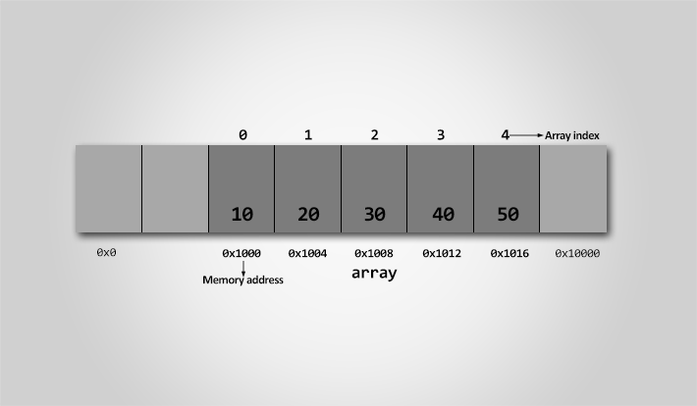
Roadmap for Today
Dynamic Memory
Classes and Dynamic Memory
Practice: Diagramming Memory

Slide 104
What is conceptually wrong with the following application?
#include <iostream>
using namespace std;
int main()
{
string employees[50];
int numEmployees = 0;
employees[0] = "Alice";
numEmployees++;
employees[1] = "Bob";
numEmployees++;
employees[2] = "Beth";
numEmployees++;
for (int i = 0; i < numEmployes; i++) {
cout << employees[i] << endl;
}
}

Slide 105
What is conceptually wrong with the following application?
#include <iostream>
using namespace std;
int main()
{
string employees[50];
int numEmployees = 0;
employees[0] = "Alice";
numEmployees++;
employees[1] = "Bob";
numEmployees++;
employees[2] = "Beth";
numEmployees++;
for (int i = 0; i < numEmployes; i++) {
cout << employees[i] << endl;
}
}
We have to specify the size of the array!
What if we have more than 50 employees?
Increasing the size will cause a recompile.

Slide 106
What is conceptually wrong with the following application?
#include <iostream>
using namespace std;
int main()
{
int size;
cin >> size;
string employees[size];
int numEmployees = 0;
employees[0] = "Alice";
numEmployees++;
employees[1] = "Bob";
numEmployees++;
employees[2] = "Beth";
numEmployees++;
for (int i = 0; i < numEmployes; i++) {
cout << employees[i] << endl;
}
delete[] employees;
}
We have to specify the size of the array!
What if we have more than 50 employees?
Increasing the size will cause a recompile.
Dynamic array sizes are not possible on the stack.

Slide 107
Solution: Use dynamic memory allocation (new / delete)
#include <iostream>
using namespace std;
int main()
{
int size;
cin >> size;
string* employees = new string[size];
int numEmployees = 0;
employees[0] = "Alice";
numEmployees++;
employees[1] = "Bob";
numEmployees++;
employees[2] = "Beth";
numEmployees++;
for (int i = 0; i < numEmployes; i++) {
cout << employees[i] << endl;
}
delete[] employees;
}
Creates a dynamic array based on input.
Deletes the dynamic array.

Slide 108
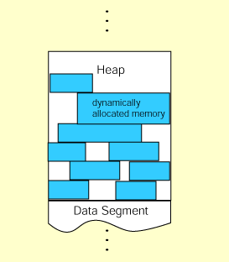
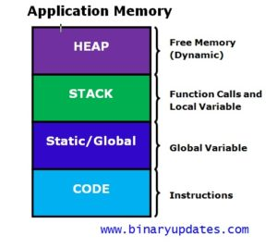
Dynamic memory allocation occurs on the heap instead of the stack.

Slide 109
The new operator creates memory on the heap instead of the stack.
Memory
#include <iostream>
using namespace std;
int main()
{
int* a = new int(5);
cout << *a << endl;
}
Variable | Value
 | 5
a

Slide 110
The new operator creates memory on the heap instead of the stack.
Memory
#include <iostream>
using namespace std;
int main()
{
int* a = new int(5);
cout << *a << endl;
}
Variable | Value
 | 5
a

Slide 111
We must always delete the allocated memory off the heap with the delete keyword.
Memory
#include <iostream>
using namespace std;
int main()
{
int* a = new int(5);
cout << *a << endl;
delete a;
}
Variable | Value
 | 5
a

Slide 112
We must always delete the allocated memory off the heap with the delete keyword.
Memory
#include <iostream>
using namespace std;
int main()
{
int* a = new int(5);
cout << *a << endl;
delete a;
}
Variable | Value
 | 5 <deleted>
a

Slide 113
Let’s look at an example. What is wrong with this program?
#include <iostream>
using namespace std;
int main()
{
int* a;
while (true) {
a = new int(5);
cout << *a << endl;
}
delete a;
}

Slide 114
A memory leak is caused when we don’t delete our allocated memory off the heap.
Memory
#include <iostream>
using namespace std;
int main()
{
int* a;
while (true) {
a = new int(5);
cout << *a << endl;
}
delete a;
}
Variable | Value
 | 5
 | 5
 | 5
 | 5
 | ...
 | 5
a

Slide 115
We can fix the memory leak by deleting every value we allocate.
Memory
#include <iostream>
using namespace std;
int main()
{
int* a;
while (true) {
a = new int(5);
cout << *a << endl;
delete a;
}
// delete a;
}
Variable | Value
 | 5
a

Slide 116
To create and destroy a dynamic array on the heap, we can use new type[] and delete[].
Memory
#include <iostream>
using namespace std;
int main()
{
int dynamicSize;
cin >> dynamicSize;
int* a = new int[dynamicSize];
a[0] = 0;
a[1] = 1;
a[2] = 2;
delete[] a;
}
Variable | Value
 | 0
 | 1
 | 2
 | ...
a

Slide 117
To create and destroy a dynamic array on the heap, we can use new type[] and delete[].
Memory
#include <iostream>
using namespace std;
int main()
{
int dynamicSize;
cin >> dynamicSize;
int* a = new int[dynamicSize];
a[0] = 0;
a[1] = 1;
a[2] = 2;
delete[] a;
}
Variable | Value
 | 0 <deleted>
 | 1 <deleted>
 | 2 <deleted>
 | ...
a

Slide 118
If we just used delete, it would not deallocate the array.
Memory
#include <iostream>
using namespace std;
int main()
{
int dynamicSize;
cin >> dynamicSize;
int* a = new int[dynamicSize];
a[0] = 0;
a[1] = 1;
a[2] = 2;
// delete[] a;
delete a;
}
Variable | Value
 | 0
 | 1
 | 2
 | ...
a
What would happen?

Slide 119
If we just used delete, it would not deallocate the array.
Memory
#include <iostream>
using namespace std;
int main()
{
int dynamicSize;
cin >> dynamicSize;
int* a = new int[dynamicSize];
a[0] = 0;
a[1] = 1;
a[2] = 2;
// delete[] a;
delete a;
}
Variable | Value
 | 0 <deleted>
 | 1
 | 2
 | ...
a
Memory Leak!

Slide 120
To create and destroy a dynamic array on the heap, we can use new type[] and delete[].
Memory
#include <iostream>
using namespace std;
int main()
{
int dynamicSize;
cin >> dynamicSize;
int* a = new int[dynamicSize];
a[0] = 0;
a[1] = 1;
a[2] = 2;
delete[] a;
}
Variable | Value
 | 0 <deleted>
 | 1 <deleted>
 | 2 <deleted>
 | ...
a

Slide 121
Stack vs. Heap: new and delete allocates memory on the heap
Stack
Heap
#include <iostream>
using namespace std;
int main()
{
int* a = new int(5);
cout << *a << endl;
delete a;
}
Type | Variable | Value
int* | a
Type | Value
int | 5
This is a picture of how the stack and heap are related.

Slide 122
Roadmap for Today
Dynamic Memory
Classes and Dynamic Memory
Practice: Diagramming Memory

Slide 123
What is wrong with the following code?
class VectorXD {
public:
VectorXD(int size) : size(size) {
array = new double[size];
}
double& operator[](int index) {
return array[index];
}
private:
int size;
double* array;
};
int main() {
VectorXD vec(5);
vec[0] = 5;
return 0;
}

Slide 124
What is wrong with the following code?
class VectorXD {
public:
VectorXD(int size) : size(size) {
array = new double[size];
}
double& operator[](int index) {
return array[index];
}
private:
int size;
double* array;
};
int main() {
VectorXD vec(5);
vec[0] = 5;
return 0;
}
Memory Leak!
(array is never deleted)
How can we fix this?

Slide 125
Let’s follow good memory management practices.
class VectorXD {
public:
VectorXD(int size) : size(size) {
array = new double[size];
}
~VectorXD() {
delete[] array;
}
double& operator[](int index) {
return array[index];
}
private:
int size;
double* array;
};
int main() {
VectorXD vec(5);
vec[0] = 5;
return 0;
}
Add Destructor
(called when variable goes out of scope)

Slide 126
Let’s follow good memory management practices.
class VectorXD {
public:
VectorXD(int size) : size(size) {
array = new double[size];
}
~VectorXD() {
delete[] array;
}
double& operator[](int index) {
return array[index];
}
private:
int size;
double* array;
};
int main() {
VectorXD vec(5);
vec[0] = 5;
VectorXD vec2(vec)
vec = vec2;
return 0;
}
Now what is wrong?

Slide 127
Let’s follow good memory management practices.
class VectorXD {
public:
VectorXD(int size) : size(size) {
array = new double[size];
}
~VectorXD() {
delete[] array;
}
double& operator[](int index) {
return array[index];
}
private:
int size;
double* array;
};
int main() {
VectorXD vec(5);
vec[0] = 5;
VectorXD vec2(vec)
vec = vec2;
return 0;
}
Copy Constructor or operator= will do a direct copy of
The data!
Changing one vector will change the data of another.
How can we fix this?

Slide 128
Let’s follow good memory management practices.
class VectorXD {
public:
VectorXD(int size) : size(size) {
array = new double[size];
}
VectorXD(const VectorXD& vec) {
array = NULL;
*this = vec;
}
~VectorXD() {
delete[] array;
}
void operator=(const VectorXD& vec) {
this->size = vec.size;
delete[] this->array;
this->array = new double[this->size];
for (int i = 0; i < size; i++) {
this->array[i] = vec.array[i];
}
}
private:
int size;
double* array;
};
Add Copy Constructor
Overload assignment operator

Slide 129
Let’s follow good memory management practices.
class VectorXD {
public:
VectorXD(int size) : size(size) {
array = new double[size];
}
VectorXD(const VectorXD& vec) {
array = NULL;
*this = vec;
}
~VectorXD() {
delete[] array;
}
void operator=(const VectorXD& vec) {
this->size = vec.size;
delete[] this->array;
this->array = new double[this->size];
for (int i = 0; i < size; i++) {
this->array[i] = vec.array[i];
}
}
private:
int size;
double* array;
};
Add Copy Constructor
Notice the copy constructor can call the assignment operator.
Overload assignment operator

Slide 130
The Big Three: Anytime a class uses dynamic memory, remember to implement these.
class VectorXD {
public:
VectorXD(int size) : size(size) {
array = new double[size];
}
VectorXD(const VectorXD& vec) {
array = NULL;
*this = vec;
}
~VectorXD() {
delete[] array;
}
void operator=(const VectorXD& vec) {
this->size = vec.size;
delete[] this->array;
this->array = new double[this->size];
for (int i = 0; i < size; i++) {
this->array[i] = vec.array[i];
}
}
private:
int size;
double* array;
};
The Big Three
Copy Constructor
Destructor
Assignment operator

Slide 131
The Big Three: Anytime a class uses dynamic memory, remember to implement these.
class VectorXD {
public:
VectorXD(int size) : size(size) {
array = new double[size];
}
VectorXD(const VectorXD& vec) {
array = NULL;
*this = vec;
}
~VectorXD() {
delete[] array;
}
void operator=(const VectorXD& vec) {
this->size = vec.size;
delete[] this->array;
this->array = new double[this->size];
for (int i = 0; i < size; i++) {
this->array[i] = vec.array[i];
}
}
private:
int size;
double* array;
};
It is often error prone to remember when you need to delete an array or pointer.
Causes a memory leak if you forget!

Slide 132
The Big Three: Anytime a class uses dynamic memory, remember to implement these.
class VectorXD {
public:
VectorXD(int size) : size(size) {
array = new double[size];
}
VectorXD(const VectorXD& vec) {
array = NULL;
*this = vec;
}
~VectorXD() {
delete[] array;
}
void operator=(const VectorXD& vec) {
this->size = vec.size;
delete[] this->array;
this->array = new double[this->size];
for (int i = 0; i < size; i++) {
this->array[i] = vec.array[i];
}
}
private:
int size;
double* array;
};
It is often error prone to remember when you need to delete an array or pointer.
Causes a memory leak if you forget!
Wouldn’t it be nice to just say new like Java
and not worry about the delete.
However, no garbage collection.

Slide 133
The Big Three: Anytime a class uses dynamic memory, remember to implement these.
class VectorXD {
public:
VectorXD(int size) : size(size) {
array = new double[size];
}
VectorXD(const VectorXD& vec) {
array = NULL;
*this = vec;
}
~VectorXD() {
delete[] array;
}
void operator=(const VectorXD& vec) {
this->size = vec.size;
delete[] this->array;
this->array = new double[this->size];
for (int i = 0; i < size; i++) {
this->array[i] = vec.array[i];
}
}
private:
int size;
double* array;
};
It is often error prone to remember when you need to delete an array or pointer.
Causes a memory leak if you forget!
Wouldn’t it be nice to just say new like Java
and not worry about the delete.
However, no garbage collection.
There is a solution!

Slide 134
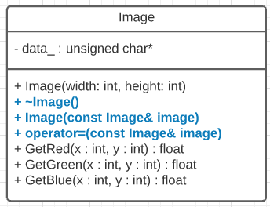
Whenever we work with dynamic memory in classes, we need to think about the Big Three.
The Big Three:
Destructor
Copy Constructor
Assignment Operator
Example:

Slide 135
Whenever we work with dynamic memory in classes, we need to think about the Big Three.
The Big Three:
Destructor
Copy Constructor
Assignment Operator
Example:
Image::Image(int width, int height) {
data_ = new unsigned char[width*height*3];
}
Image::~Image() {
delete[] data_;
}
Image::Image(const Image& image) {
*this = image;
}
void Image::operator=(const Image& image) {
delete[] data_;
data_ = new unsigned char[image.GetSize()];
memcpy(data_, image.data_, image.GetSize());
}
Calls assignment operator.

Slide 136
Whenever we work with dynamic memory in classes, we need to think about the Big Three.
The Big Three:
Destructor
Copy Constructor
Assignment Operator
Example:
Image::Image(int width, int height) {
data_ = new unsigned char[width*height*3];
}
Image::~Image() {
delete[] data_;
}
Image::Image(const Image& image) {
*this = image;
}
void Image::operator=(const Image& image) {
delete[] data_;
data_ = new unsigned char[image.GetSize()];
memcpy(data_, image.data_, image.GetSize());
}
Calls assignment operator.
this keyword is a pointer to the current class.
*this dereferences the pointer to get the value.

Slide 137
Summary
* & ->
Pointers
Pointers are memory addresses
The can point to any location in memory.
The memory doesn’t need to exist (e.g. NULL).
new / delete
Dynamic Memory
Anytime a new is used on the heap, there must be a delete.
If you allocate with new[] you must delete memory with delete[].
The Big Three (destructor, copy constructor, assignment operator)

Slide 138
Object Slicing
Show code example
Code is uploaded in Canvas

Slide 139
Roadmap for Today
Dynamic Memory
Classes and Dynamic Memory
Practice: Diagramming Memory

Slide 140
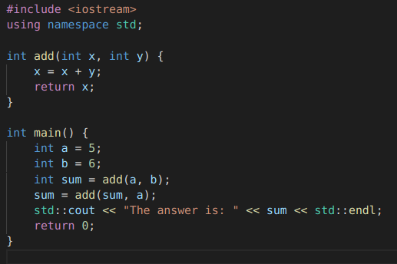
Example 1: Pass by Value
Memory
Type | Name | Value

Slide 141
Example 1: Pass by Value
Memory
Type | Name | Value
int | a | ?
int | b | ?
int | sum | ?
Add variables to the stack.

Slide 142
Example 1: Pass by Value
Memory
Type | Name | Value
int | a | ? 5
int | b | ?
int | sum | ?
Initialize

Slide 143
Example 1: Pass by Value
Memory
Type | Name | Value
int | a | ? 5
int | b | ? 6
int | sum | ?
Initialize

Slide 144
Example 1: Pass by Value
Memory
Type | Name | Value
int | a | ? 5
int | b | ? 6
int | sum | ?
int | x | ?
int | y | ?
Add variables to the stack.

Slide 145
Example 1: Pass by Value
Memory
Type | Name | Value
int | a | ? 5
int | b | ? 6
int | sum | ?
int | x | ? 5
int | y | ? 6
Copy Values

Slide 146
Example 1: Pass by Value
Memory
Type | Name | Value
int | a | ? 5
int | b | ? 6
int | sum | ?
int | x | ? 5 11
int | y | ? 6
Add and store

Slide 147
Example 1: Pass by Value
Memory
Type | Name | Value
int | a | ? 5
int | b | ? 6
int | sum | ? 11
int | x | ? 5 11
int | y | ? 6
Return value and set

Slide 148
Example 1: Pass by Value
Memory
Type | Name | Value
int | a | ? 5
int | b | ? 6
int | sum | ? 11
 |  | ? 5 11
 |  | ? 6
Pop variables off the stack

Slide 149
Example 1: Pass by Value
Memory
Type | Name | Value
int | a | ? 5
int | b | ? 6
int | sum | ? 11
int | x | ? 5 11
int | y | ? 6
Add variables to the stack.

Slide 150
Example 1: Pass by Value
Memory
Type | Name | Value
int | a | ? 5
int | b | ? 6
int | sum | ? 11
int | x | ? 5 11 11
int | y | ? 5 5
Copy Values

Slide 151
Example 1: Pass by Value
Memory
Type | Name | Value
int | a | ? 5
int | b | ? 6
int | sum | ? 11
int | x | ? 5 11 11 16
int | y | ? 5 5
Add and store

Slide 152
Example 1: Pass by Value
Memory
Type | Name | Value
int | a | ? 5
int | b | ? 6
int | sum | ? 11 16
int | x | ? 5 11 11 16
int | y | ? 5 5
Return value and set

Slide 153
Example 1: Pass by Value
Memory
Type | Name | Value
int | a | ? 5
int | b | ? 6
int | sum | ? 11 16
 |  | ? 5 11 11 16
 |  | ? 5 5
Pop variables off the stack

Slide 154
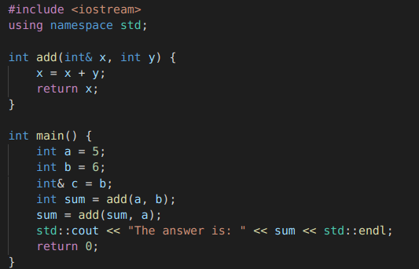
Example 2: Pass by Reference
Memory
Type | Name | Value

Slide 155
Example 2: Pass by Reference
Memory
Type | Name | Value
int | a | ?
int | b | ?
int& | c
int | sum | ?
Add variables to the stack.

Slide 156
Example 2: Pass by Reference
Memory
Type | Name | Value
int | a | ?
int | b | ?
int& | c
int | sum | ?
Add variables to the stack.
Complete Together In Class

Slide 157
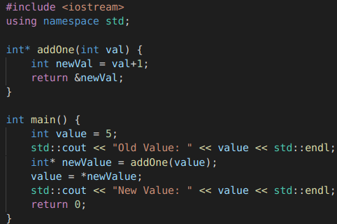
Example 3: Segmentation Fault
Add variables to the stack.
Complete Together In Class

Slide 158
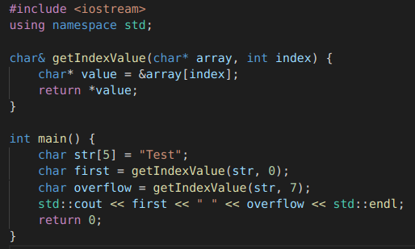
Example 4: Buffer Overflow
Add variables to the stack.
Try on your own.

